Slide 1


Gandhi Institute of Science and Technology Kholiguda ,Rayagada,Odisha Seminar : NanoTechnology
Kothakota Aaksshay Kumandan
Branch :CSE B.Tech Final Year
Regd No :1901317069

Slide 2
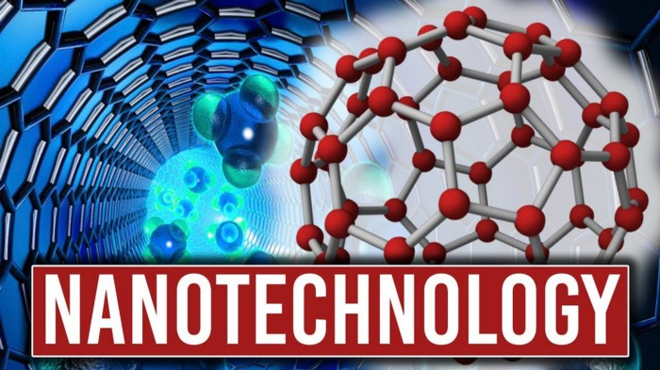

Slide 3

Introduction to Nano Technology
Nanotechnology has enormous potential to change society and it involves manipulation of objects on the atomic level.
The products will be build on every atom that are stronger ,smarter ,cheaper ,cleaner & more precise.
Nanotechnology is the art & science of manipulating matter at the nanoscale down to 1/100,000 the width of a human hair to create new & unique materials & products.

Slide 4
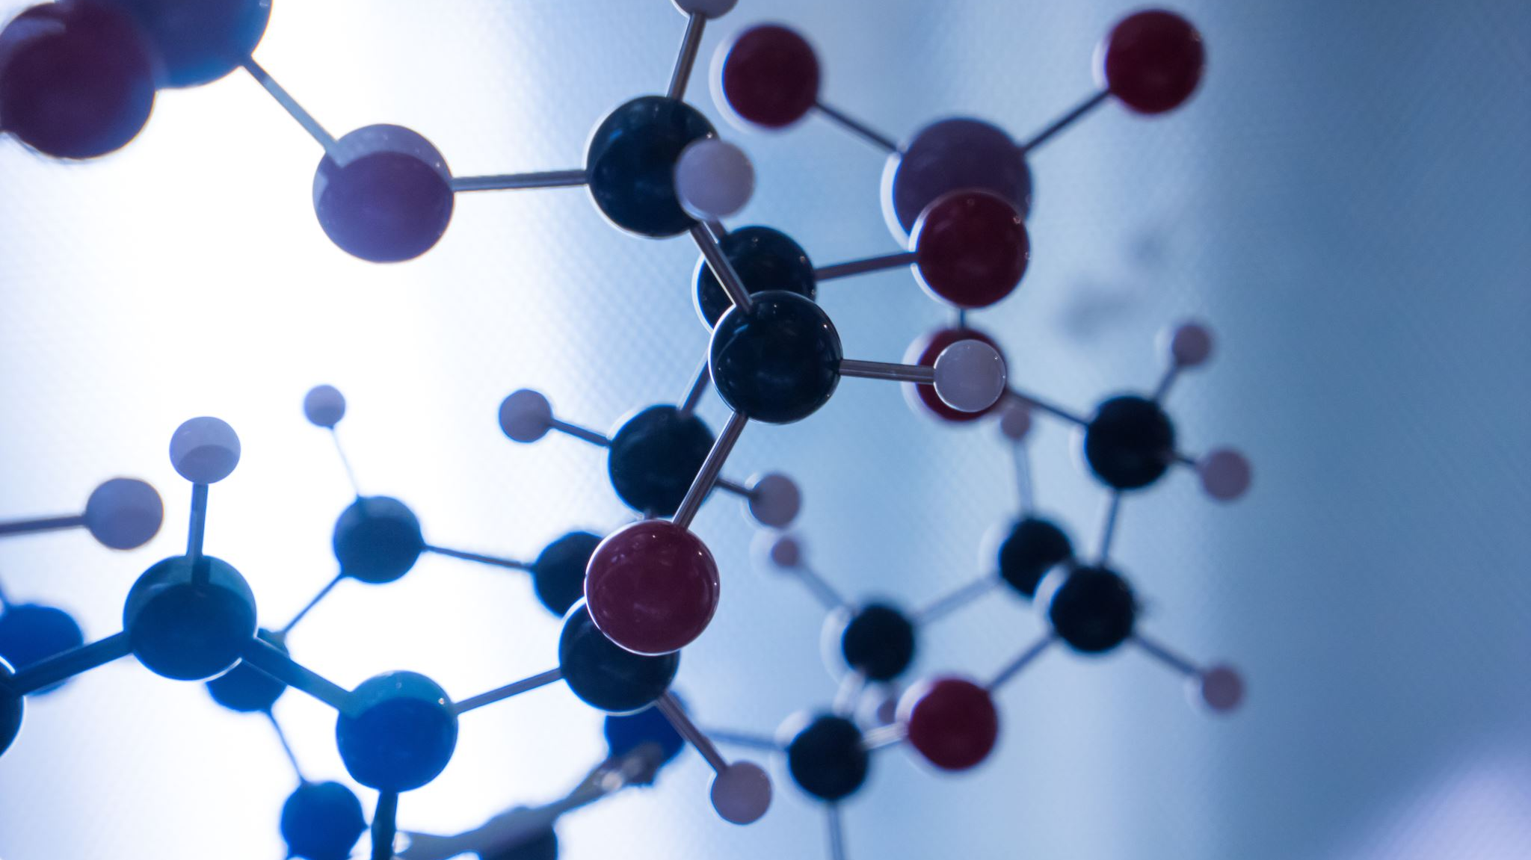
Origins of Nano Technology
Noble prize winner Richard Feynman first conceived the idea of molecular manufacturing in his 1959 speech, "There's Plenty of Room at the Bottom."
Richard Feynman was the first scientist to suggest that devices &materials could someday be fabricated to atomic specifications.
In 1986, K .Eric Drexler wrote "Engines of Creation" & introduced the term nanotechnology from there Scientific research really expanded over the last decade.

Slide 5
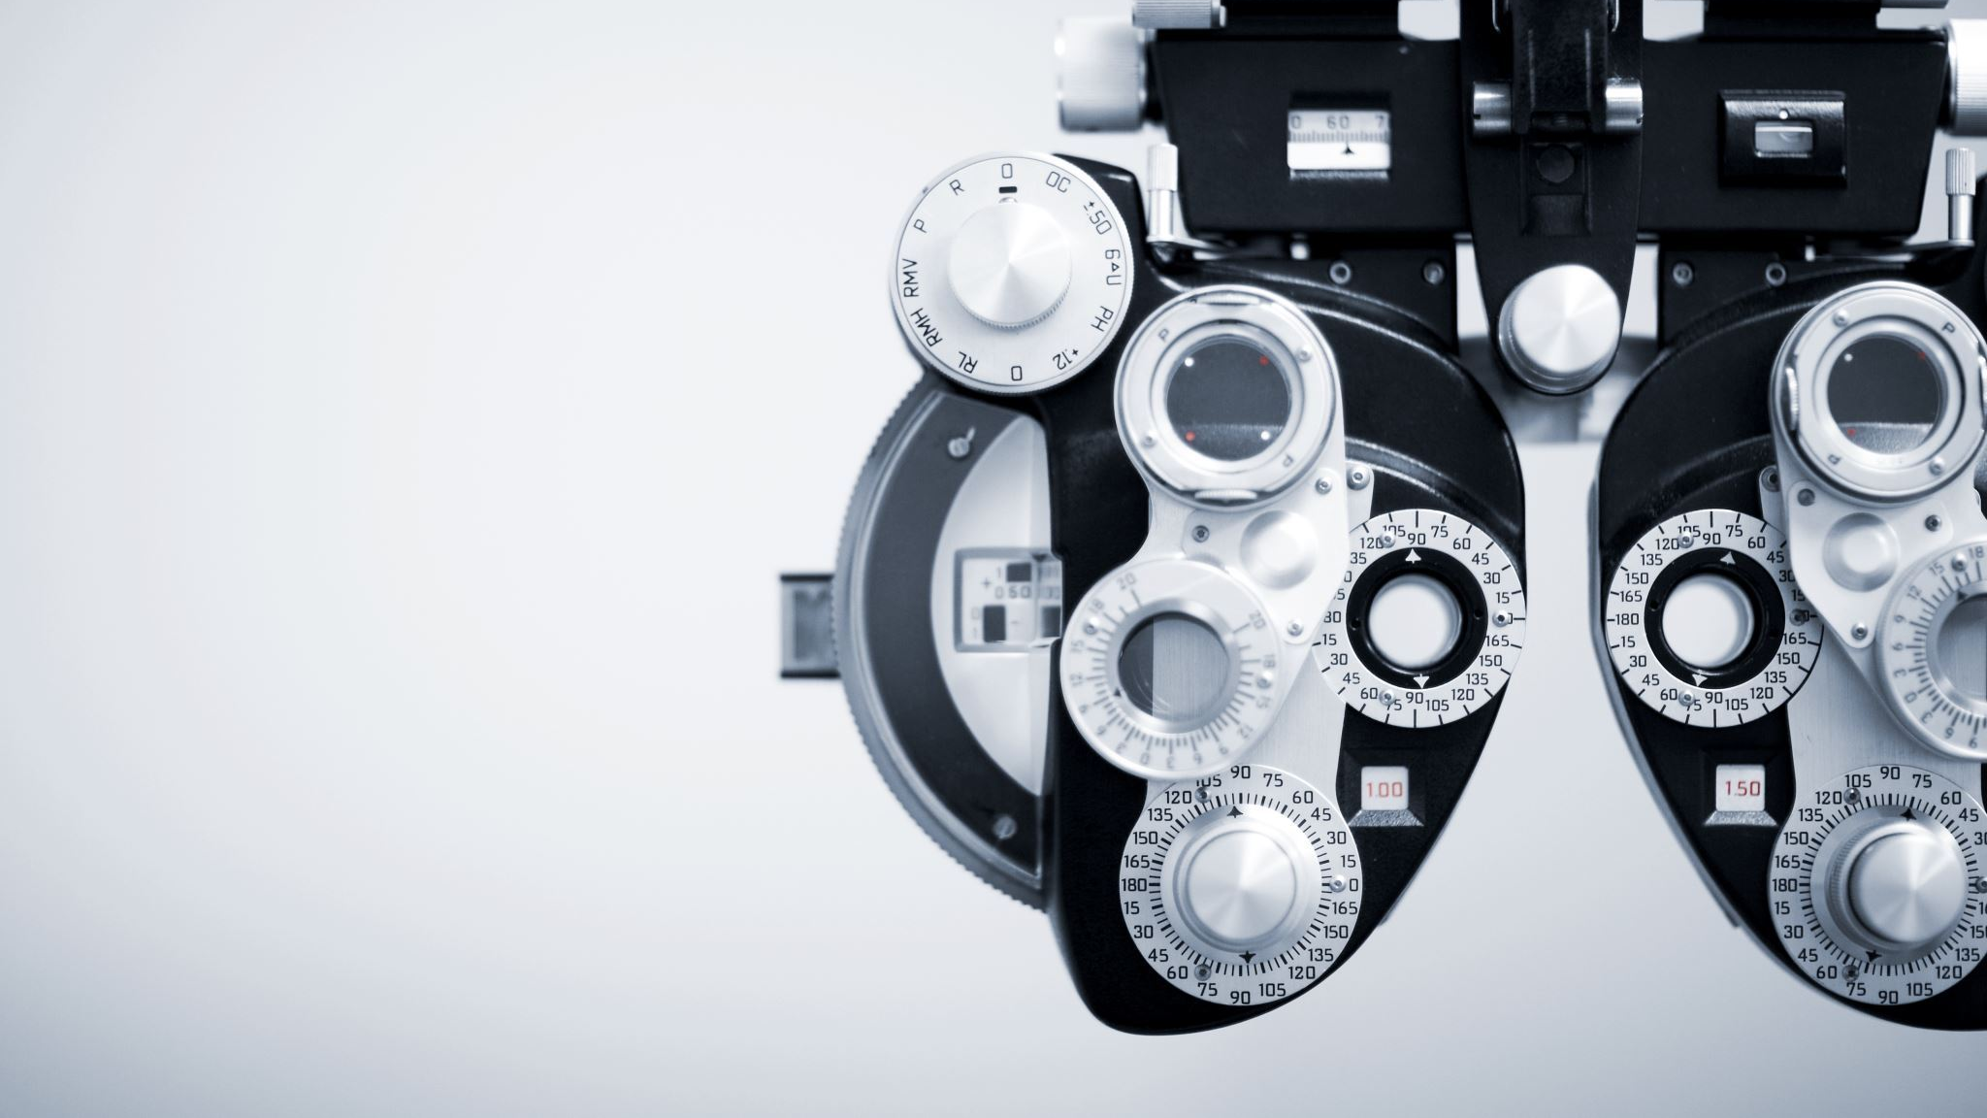
Definition of Nanotechnology
Nanotechnology is the understand & control of matter at dimensions of roughly 1 to 100 nanometers, where unique phenomena enable novel applications.
Encompassing nanoscale science ,engineering & technology ,nanotechnology involves imaging, measuring ,modeling & manipulating matter at this length scale.
.

Slide 6
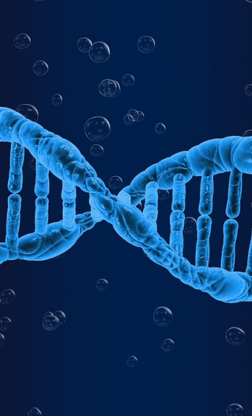

How Small Is Nano Scale?
A nanometer is one billion of a meter.

Slide 7
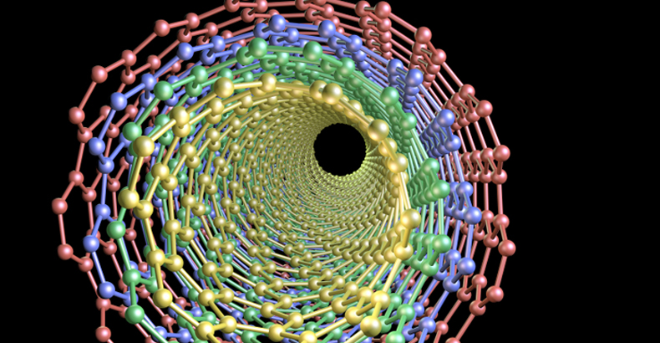
Why Nano Technology?
At the nanoscale, the physical ,chemical, & biological properties of materials differ in fundamentals & valuable ways from the properties of individual atoms & molecules or bulk matter.
Nanotechnology R & D I is directed forward understanding &creating improved materials ,devices , & systems that exploit these new properties.

Slide 8
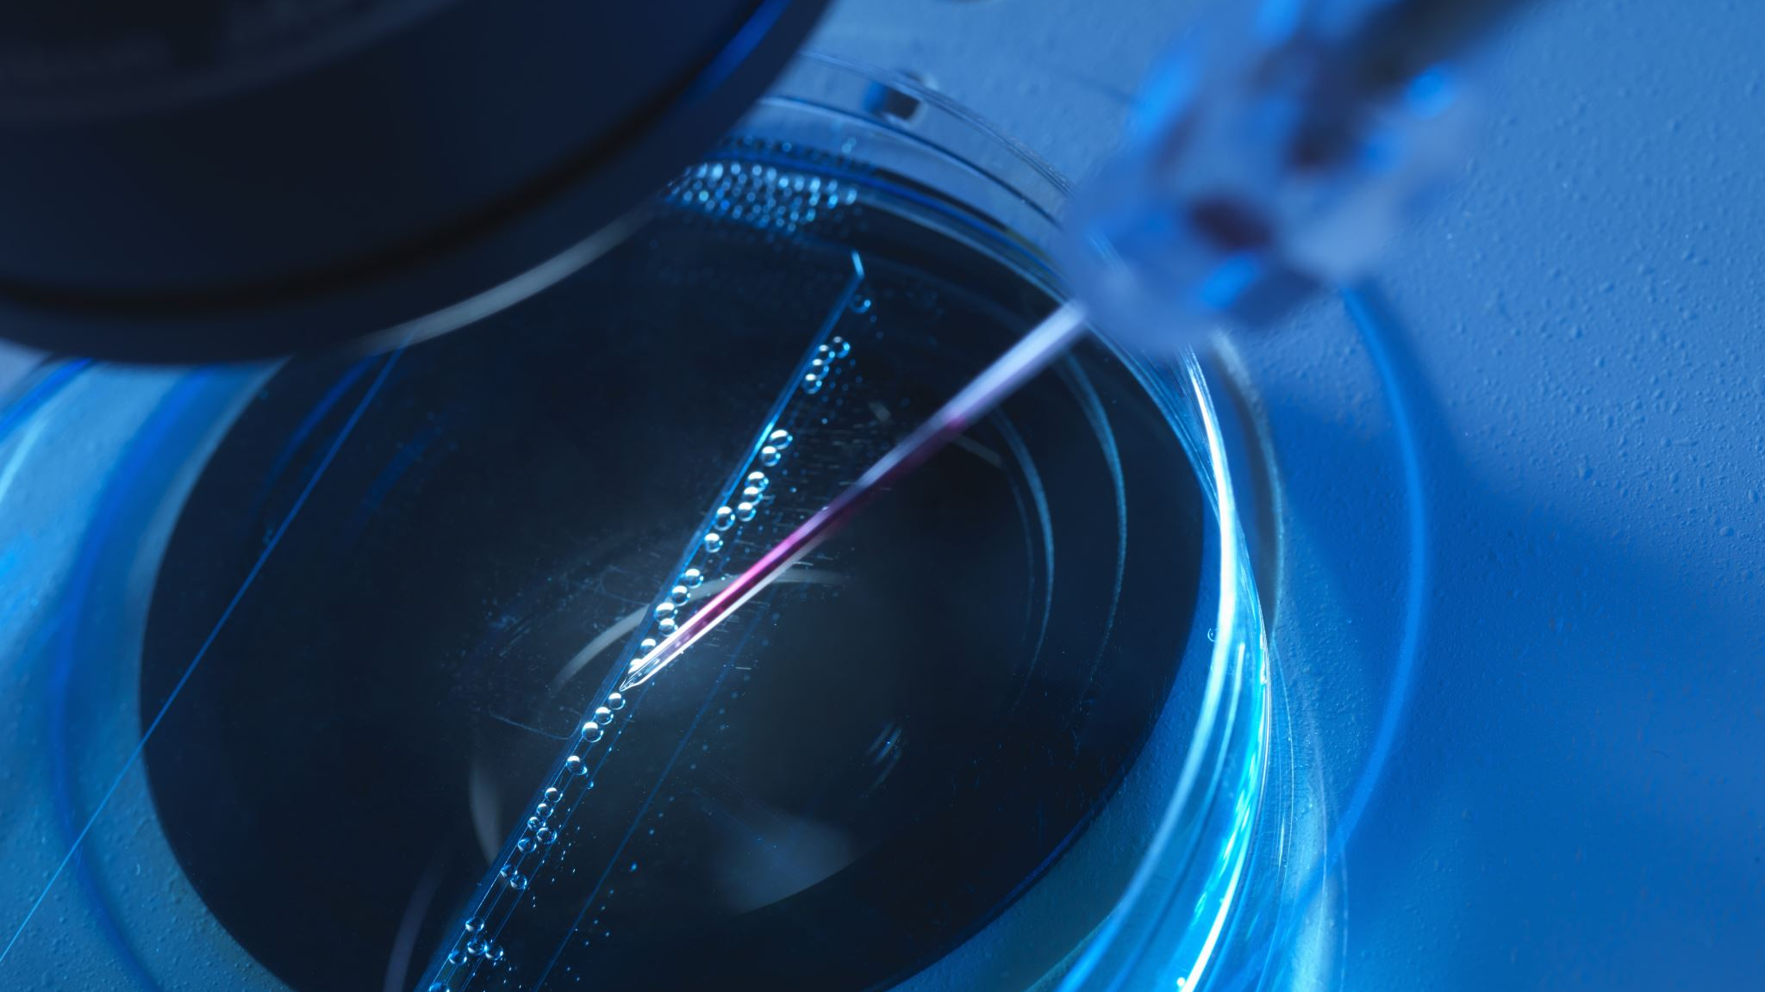
What is Nano material
Is defined as any material that has unique or novel properties , due to the nanoscale structuring.
These are formed by incorporation or structuring of nanoparticles.
They are subdivided into nanocrystals ,nano powders & nanotubes.
A sequence of nanoscale of C60 atoms arranged in a long thin cylindrical structure.

Slide 9
Nano Material Characteristics
Category Of Nanomaterials | Example
One –Dimensional Nanomaterials | Layers ,multilayers ,thin films platelets & surface coating. They have been developed & user for decades ,particularly in the electronics industry.
Two – Dimensional Nanomaterials Three –Dimensional Nanomaterials | Nanowires ,nano fibers made from a variety of element other than carbon, nanotubes & a subset of this group, carbon nanotubes. It is known as nanoparticles & include precipitates ,colloids & quantum dots & Nanocrystalline materials.

Slide 10
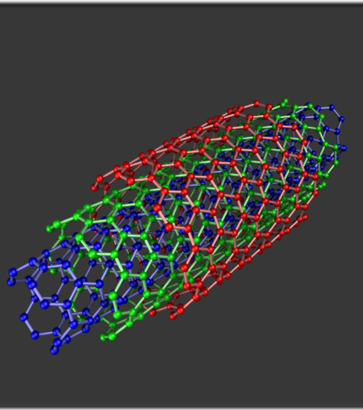
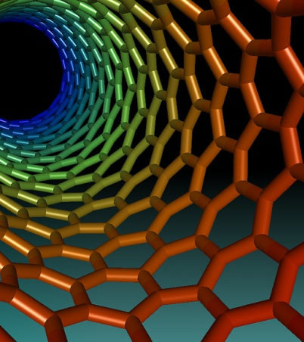
Various products in Nanotechnology
Building Products –45
Automotive –25
Marine Products – 2
Textile & fabric –17
Medical & health –31
Nanoparticles – 65
Electronics & computers – 16
Industrial Products –75
Cosmetics –27
Food – 16
Home & Garden –37
R & D -7

Slide 11
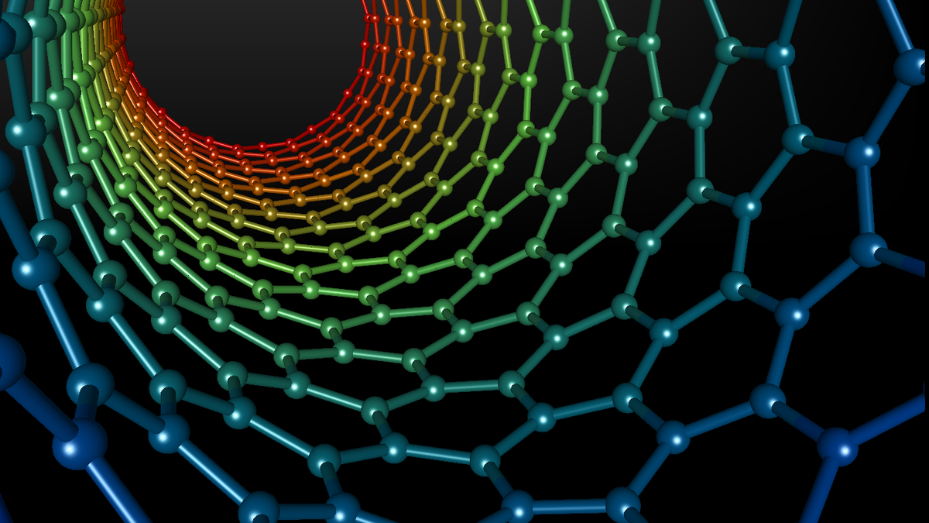
Applications Of Nanotechnology
Electronics
Nano Transistors
Nano Diodes
OLED (Organic Light Emitting Diode)

Slide 12
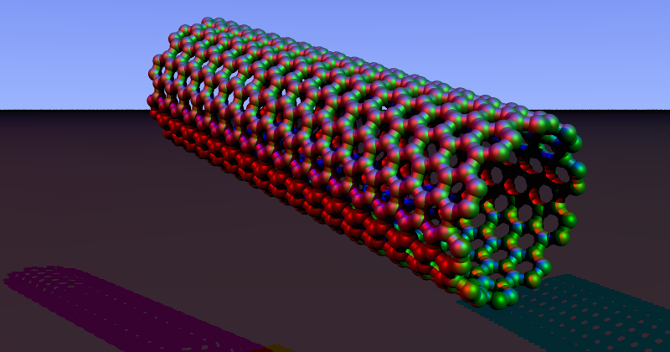
Applications Of Carbon Nano Tubes
Easton –Bell Sports ,Inc. using CNT in making bicycle component.
Zyvex Technologies using CNT manufacturing of light weight boats.
Replacing transistors from the silicon chips as they are small & emit less heat.
In electric cables & wires.
In solar cells
In Fabrics

Slide 13
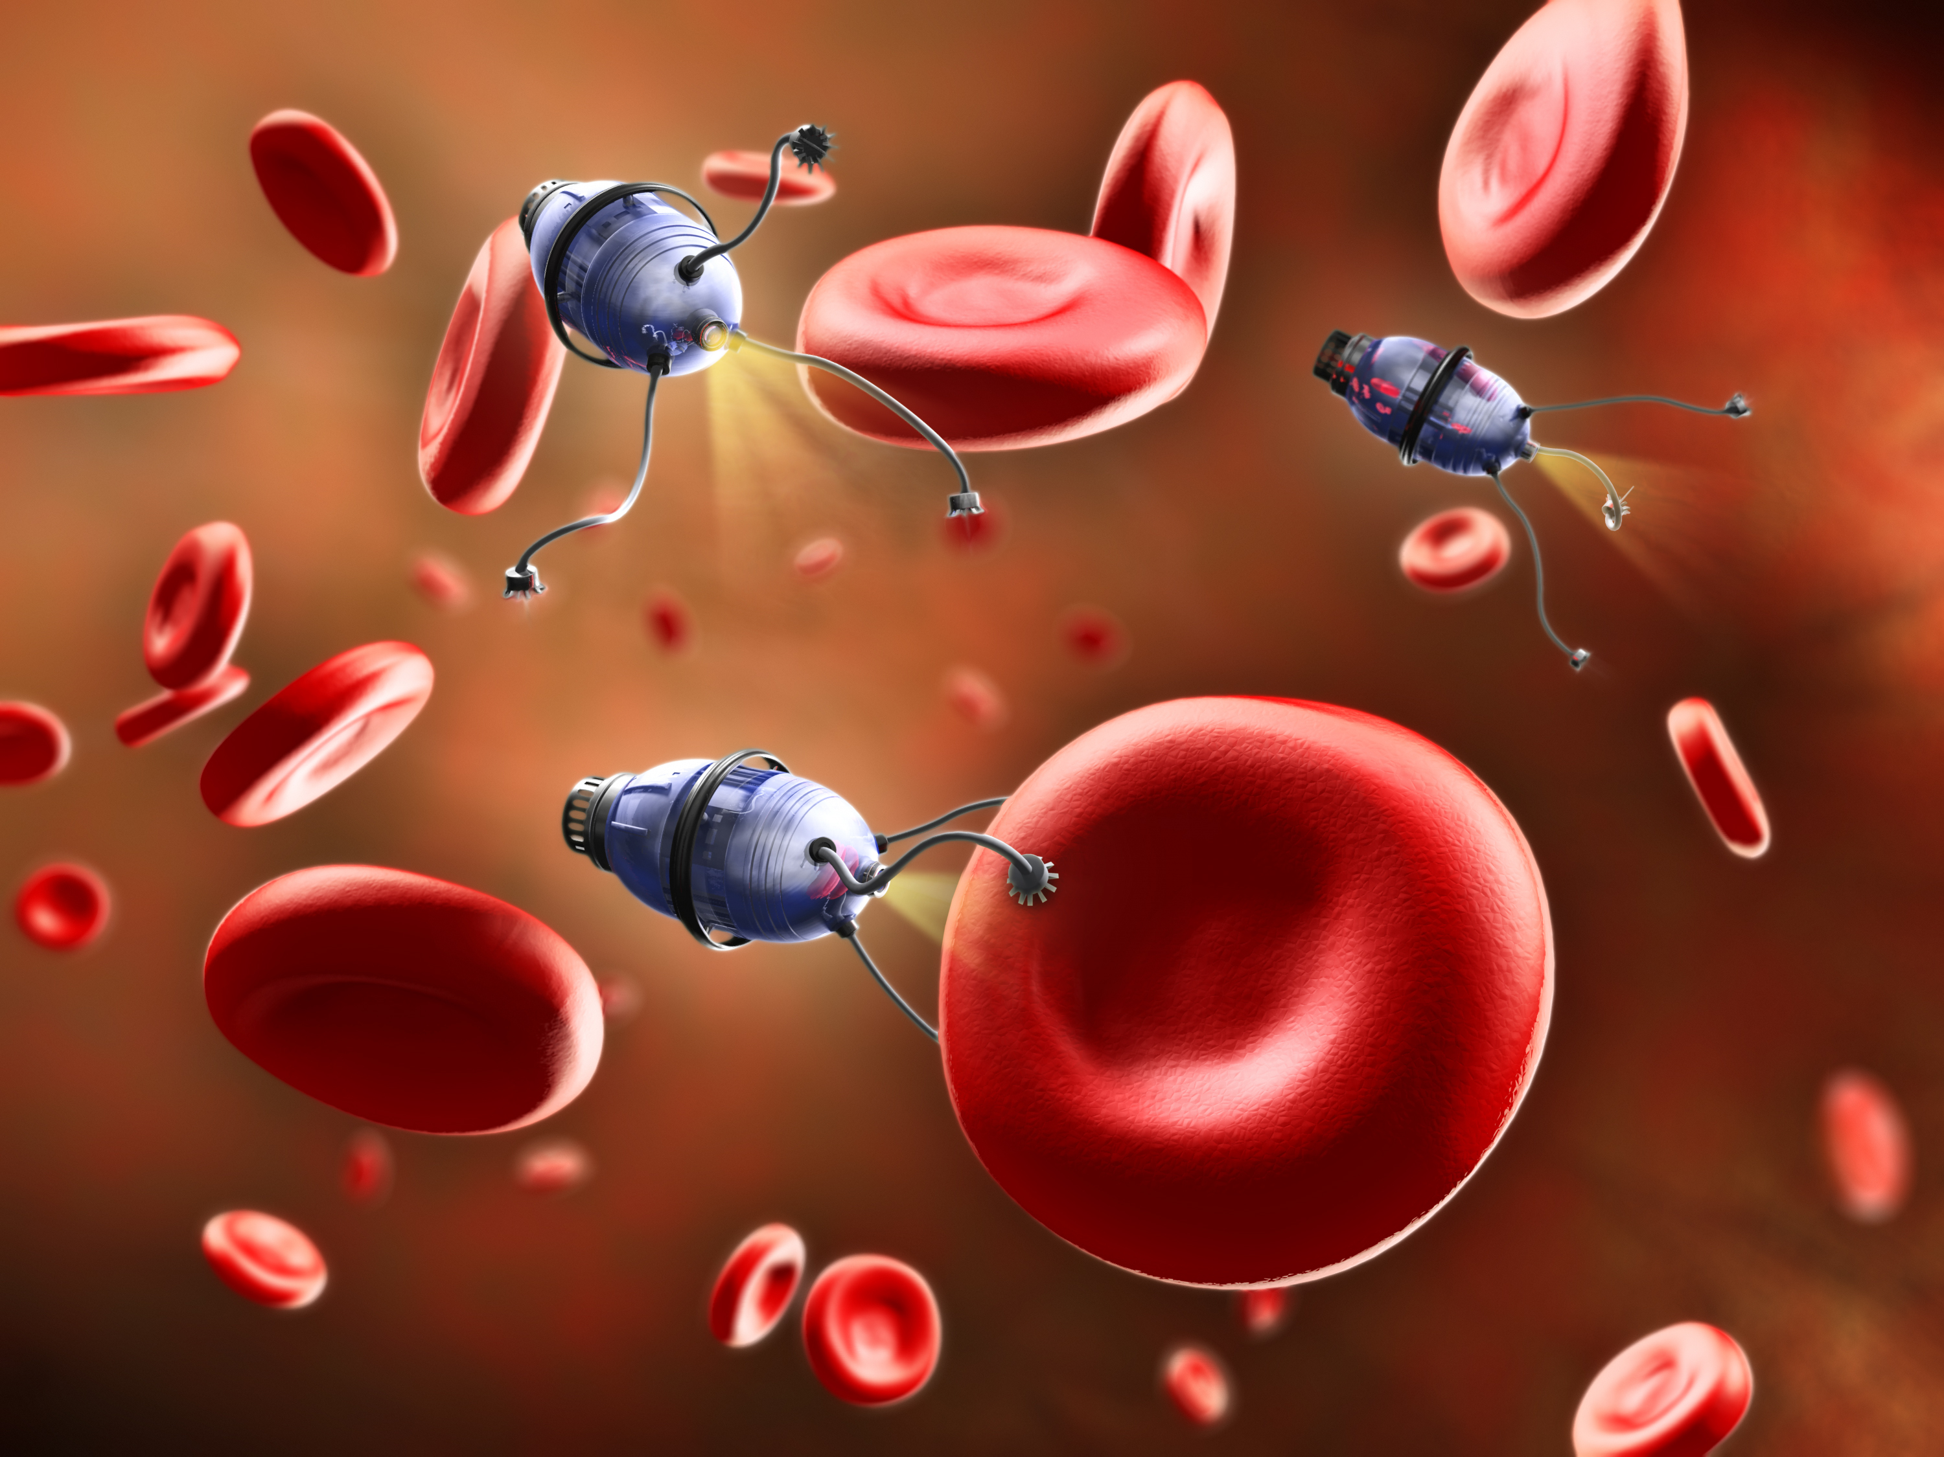
Nanobots
Close to the scale of 10^-9.
Largely in R &d phase.
Nanobots of 1.5 nanometers across ,capable of counting specific molecules in a chemical sample.
Since nanorobots would be microscopic in size, it would probably be necessary for very large numbers of them to work together to perform microscopic & macroscopic tasks.
Capable of replication using environmental resources.

Slide 14
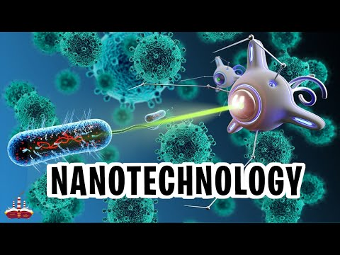

Slide 15
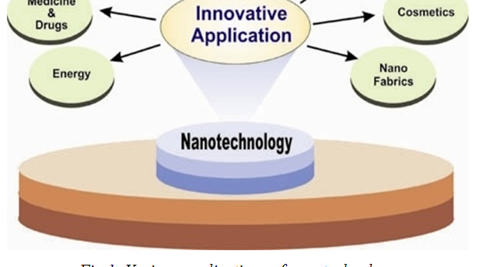
Applications Of Nanotechnology

Slide 16
Nano Technology in Drugs(Cancer)
Provide new option for drug delivery & drug therapies.
Enable drugs to be delivered to precisely the right location in the body &release drug does on a predetermined schedule for optimal treatment.
Attach the drug to a nanosized carrier.
Nanobots can clear the blockage in arteries.
They release the medicine that kills the tumour.
Current treatment is through radiotherapy or chemotherapy.

Slide 17
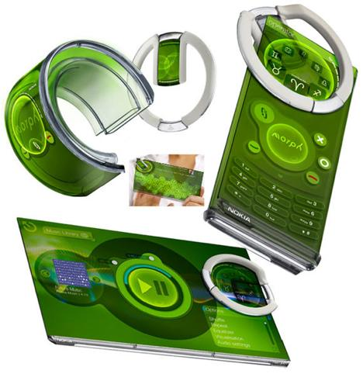
NANO Technology in Mobiles
A nanotechnology concept device developed by Nokia Research Center (NRC) & the University of Cambridge(UK).
Nanoscale electronics also allow stretching.
Nokia envisage that a nanoscale mesh of fibers will allow our mobiles devices to be bent ,stretched & folded into any number of conceivable shapes.

Slide 18
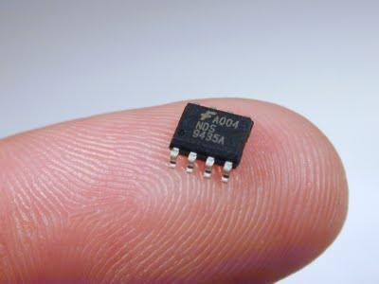
NANO TECHNOLOGY IN ELECTRONICS
Electrodes made from nanowires enable flat panel displays to be flexible as well as thinner than current flat panel displays.
Nanolithography is used for fabrication of chips.
The transistors are made of nanowires ,that are assembled on glass or thin films of flexible plastic.
E- paper ,displays on sunglasses & map on car windshields.
T

Slide 19

NANO TECHNOLOGY IN COMPUTERS
The silicon transistors in your computer may be replaced by transistors based on carbon nanotubes.
Nanorods is a upcoming technology in the display techniques due to less consumption of electricity & less heat emission.
Size of the microprocessor are reduced to greater extend.
By reducing the diameter of the nanowires, researchers believe memristor memory chips can achieve higher memory density than flash memory chips.

Slide 20
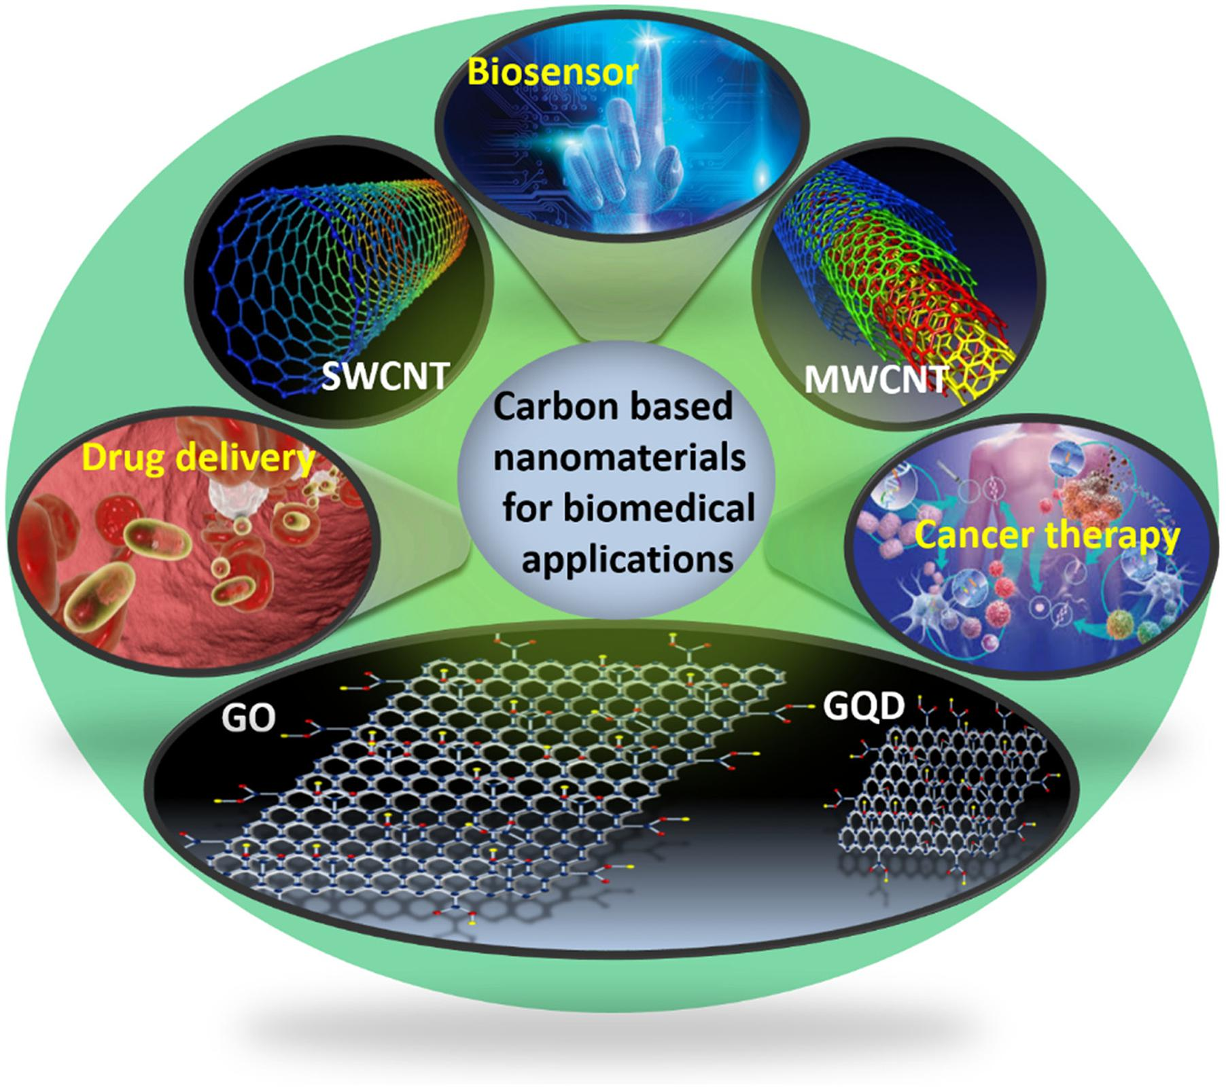
Advantages of using Carbon Nanotubes
Faster and smaller – Carbon nanotubes can be used to produce smaller & faster components.
High speed & high capacity memory.
Allows circuits to be more accurate on the atomic level.

Slide 21

Nano Technology In India
IIT Mumbai is the premier organization in the field of nanotechnology.
Starting in 2001 the Government of India launched the Nano Science & Technology Initiative (NSIT).
The Main objectives of the Nano Mission are
Basic research promotion
Infrastructure development for carrying out front –ranking research.
Human resource development & international collaborations.

Slide 22

Possibilities for the Future
Doctors inside your body Wearable fitness technology means we can monitor our health by strapping gadgets to ourselves.
2. Sensors, sensors, everywhere These sensors rely on newly-invented nanomaterials and manufacturing techniques to make them smaller, more complex and more energy efficient.
3. Self-healing structures .
4. Making big data possible .
5. Tackling climate change .

Slide 23


